Slide 1
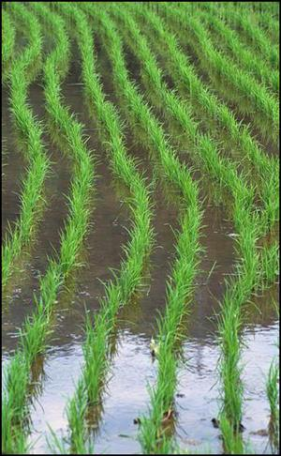
American Agricultural Development
AG 101
Ag & The Modern World

Slide 2
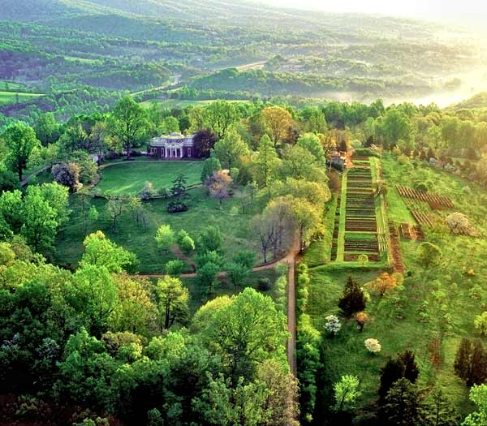
“Those who labor in the earth, are the chosen people of God.”
Thomas Jefferson - 1784

Slide 3
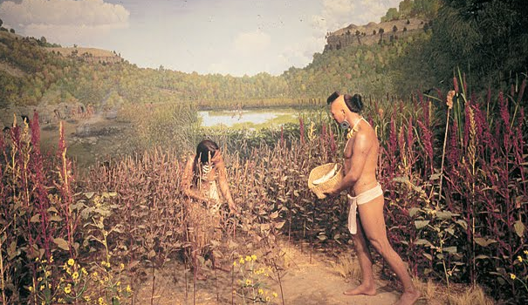
Native American Farming: Pre Colonial Contact
Influenced by Mesoamerican Indians
American Indians manipulate land for crops
Primarily with fire (slash & burn) over centuries
Practiced soil rotation
Cultivated maize, beans, squash
Larger populations in the South due to more sophisticated agricultural systems
Notes:
Independence would come from England in 1793. Founding fathers would develop a new system of land distribution. At that point, they agreed all unsettled land would come under the authority of the federal government, which could then sell it.
Settlers would be able to own clear title to land after having remained on the land and worked on the land via the Homestead Act of 1862.

Slide 4
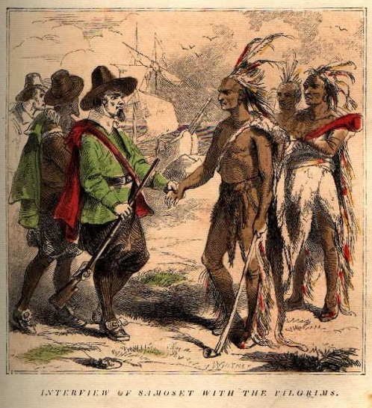
Native American Farming: Post Colonial Contact
Epidemic diseases introduced by Spaniards
  Wiped out entire native populations in Caribbean
  Mortalities from disease also seen in Southeast
  Mississippian Indian cultures decimated by disease by 1600
Deaths greater among old and young
  Loss of manpower made it difficult to maintain agricultural systems and fire regimes
  Loss of elderly, storehouse of knowledge, tradition and custom
Arrival of English continued epidemic diseases
Notes:
Independence would come from England in 1793. Founding fathers would develop a new system of land distribution. At that point, they agreed all unsettled land would come under the authority of the federal government, which could then sell it.
Settlers would be able to own clear title to land after having remained on the land and worked on the land via the Homestead Act of 1862.

Slide 5
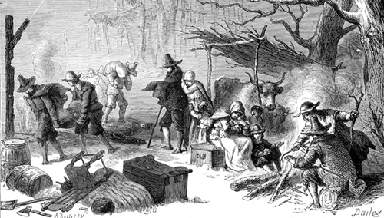
The 1600’s
Establishment of the American Colonial Period
  Land remained under British control
  British Crown carved land into large chunks and granted to private companies or well connected individuals
  Grantees divided land further and sold to other individuals
Settlers in this century were often poor
  Settled as “squatters” without clear title to land
  Believed land should be given for free if they remained on the land worked land

Slide 6
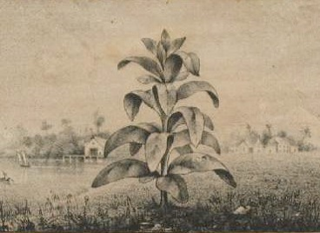
The 1600’s
As the English gained control of America, their merchants sought new markets for colony crops.
  The British government imposed heavy duties on many agricultural products from the colonies and limited the export of more valuable products like tobacco, indigo, wheat and livestock.
  These restrictions created resentment among the Colonists and were a major cause of the American Revolution.
During the winter of 1609 to 1610, two-thirds of the settlers in Jamestown, Virginia, the first permanent English settlement in America died.
Native Americans taught the survivors how to grow corn, pumpkin and squash.
Corn and beans were planted together in small mounds so the bean vines could grow up along the cornstalks.
The beans also added nitrogen to the soil. Pumpkins and other kinds of squash were planted between the mounds. Seeds were saved for the next year’s crop.

Slide 7
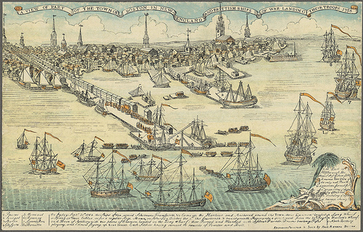
The 1700’s
Northern farmers produce a variety of crops and livestock
  Sometimes supplemented by craftwork
Southern “Plantation” agriculture concentrates on export crops
  Tobacco = main cash crop
Colonies export:
  Tobacco
  Rice
  Indigo
  Grain
  Meat products
Local governments often regulate the prices of basic food

Slide 8
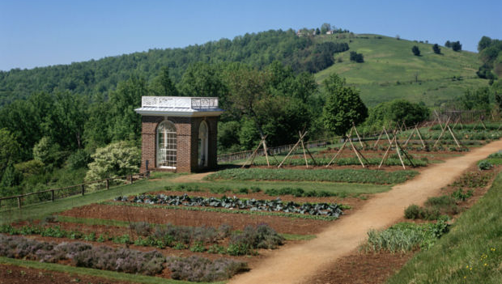
American Agrarianism
Agrarian: defined by Merriam-Webster
  of or relating to or characteristic of farmers or their way of life
  of or relating to fields or lands or their tenure
Agrarianism: defined by Merriam-Webster
  “a social or political movement designed to bring about land reforms or to improve the economic status of the farmer”
US has a history of political commitment to place control of land under primary producers (vs. European feudal system, land owned by aristocrats and landlords)

Slide 9
American Agrarianism
“Cultivators of the earth are the most valuable citizens. They are the most vigorous, the most independent, the most virtuous, and they are tied to their country, and wedded to its liberty and interests by the most lasting bonds.”
Thomas Jefferson, Farmer
Political duty is to preserve and protect farmers
A population that owns & works its land is less susceptible to short-term, unstable government policies
Farming creates democratic virtues (moral standards)
Independence and self-reliance
    Commitment to the common good
Farmers are virtuous, their means of making a living meld together private and public interest
Notes:
Thomas Jefferson - a main author and signer of the Declaration of Independence.
Assertions made by T Jefferson’s statement:
Political duty to preserve…
- A population that owns & works it’s land is less susceptable to short term unstable ….

Slide 10
American Agrarian Philosophy
“I know of no other pursuit in life in which more real and important services can be rendered to any country than by improving its agriculture, its breed of useful animals, and other branches of husbandman’s care.” George Washington
“Those who labor the earth are the chosen people of God.” Thomas Jefferson
Science and development of the scientific method influenced plant cultivation, animal husbandry, development of agricultural technology
Early settlers went to the New World to escape religious persecution
  Farming perceived as a spiritual quest of faith

Slide 11
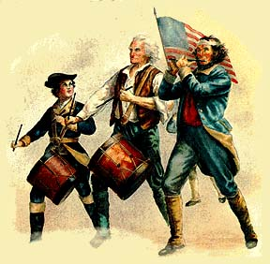
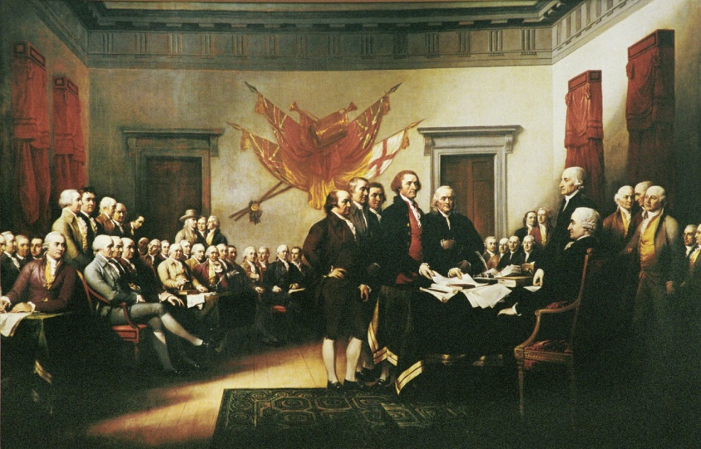
American Revolution: 1776
Colonies revolted against trade
taxations and power of England
over them.
1776: Declaration of Independence = Partially a result of British controls on:
  Farm exports
  Restrictions on land titles
  Limitations on western settlement

Slide 12
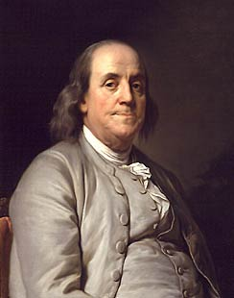
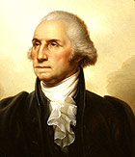
Did you know?
1780: U.S. Ambassador Ben Franklin sends soybeans back from France
1786: George Washington breeds the first mules in the U.S.
  Used animals given to him by the King of Spain
  Also experimented with crop rotation

Slide 13
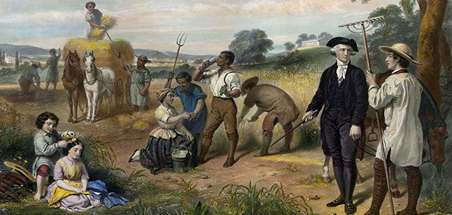
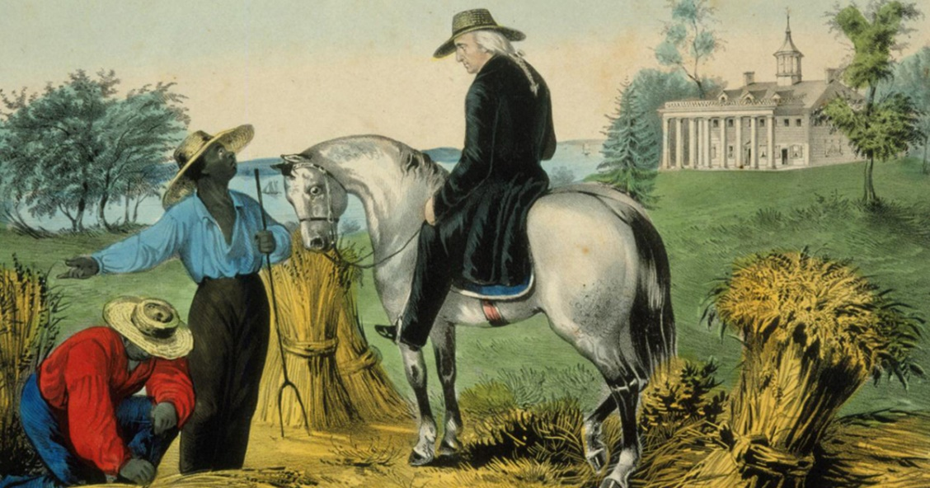
The 1700’s
Both Washington and Jefferson were interested in experimenting with agriculture.
Washington: At his Mount Vernon, Virginia farm, Washington experimented with crop rotation and with new seeds and plants. He also became the Nation’s first mule breeder, using animals given to him by the king of Spain.
Jefferson: Enjoyed experimenting with agriculture on his Virginia estate at Monticello.
Both Washington and Jefferson helped organize societies for improving agriculture. These societies were pioneers in agricultural science and education. Some societies issued reports, published journals, and sponsored agricultural fairs to encourage agricultural improvement.
93% of early Americans were farmers

Slide 14
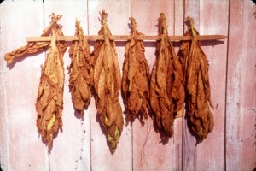
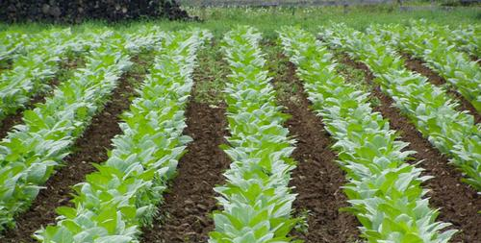
1790’s
1790:
  Total Population = 3.9 million
    90% = Farmers
  Value of tobacco exports = $4.4 million
    = 44% of total exports

Slide 15
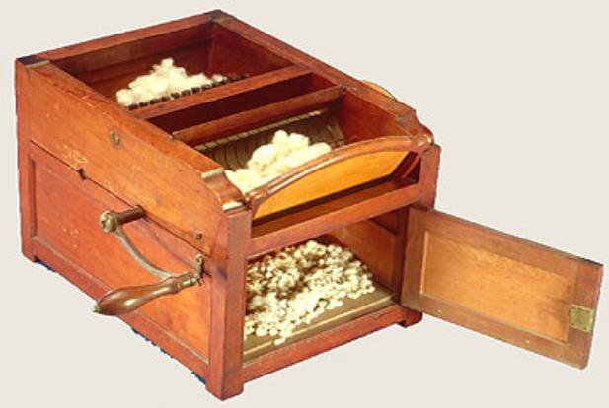
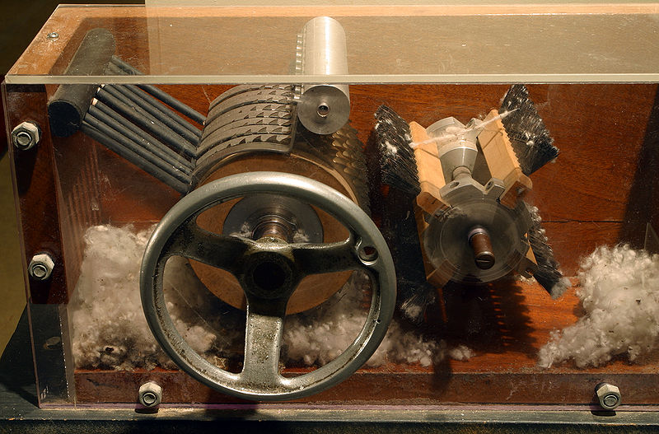
1790’s Innovations
1793 = Invention of Cotton Gin (Eli Whitney)
  Revolutionized the Cotton Industry
  +/- effects

Slide 16
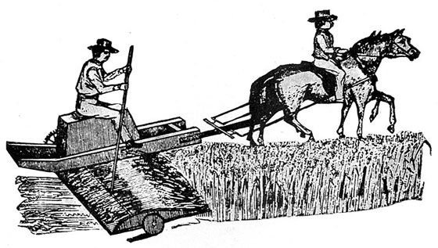
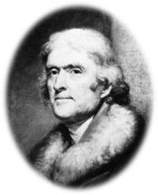
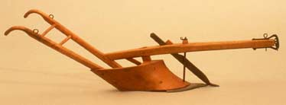
1790’s Innovations
1797 = first cast-iron plow patented
Began to use horsepower to pull newly invented farm implements
  Broadcast seeder
  Mechanized Reaper
1794 = Thomas Jefferson creates plow with lower resistance moldboard
  Thomas Jefferson writes about American Agriculture as a way of life (“Agrarian”)

Slide 17
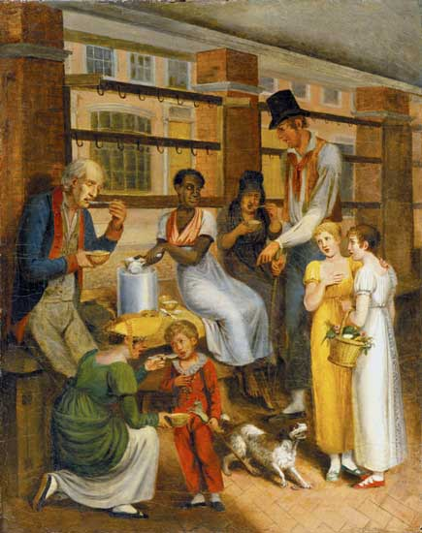
1790’s
1796: Public Land Act
  Allows Federal land sales to the public
  Minimum of 640-acre plots
  $2 per acre of credit
Immigrants:
  Came to America in droves, exchanging
  their own indentured labor for passage.
1799:
  George Washington suggests to Congress the establishment of a National Board of Agriculture

Slide 18
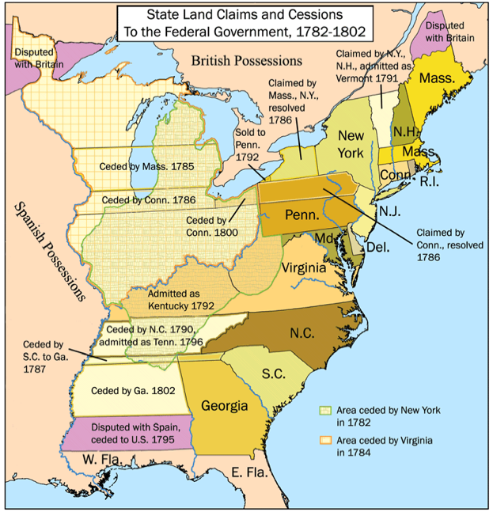
The 1800’s
1800:
  Total Population
  = 5.3 million
  Average value of Ag exports
  = $23 million
    75% of total exports

Slide 19
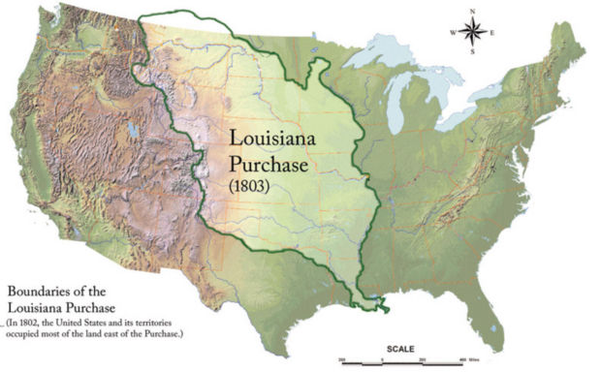
1803: The Louisiana Purchase
$15 million
Roughly doubled the size of U.S. territory
President Thomas Jefferson justified the purchase as a means to provide enough fertile land to expand the Agrarian way of life
“Agrarian” = relating to farmers and their way of life
Jefferson wanted to create a country of small farms living independently in states under U.S. governance
  Felt farmers had the virtues needed to sustain a Democratic society

Slide 20
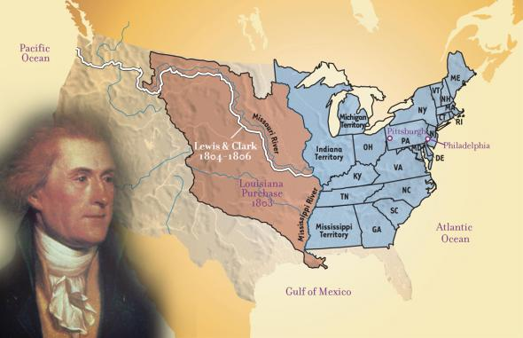

Slide 21
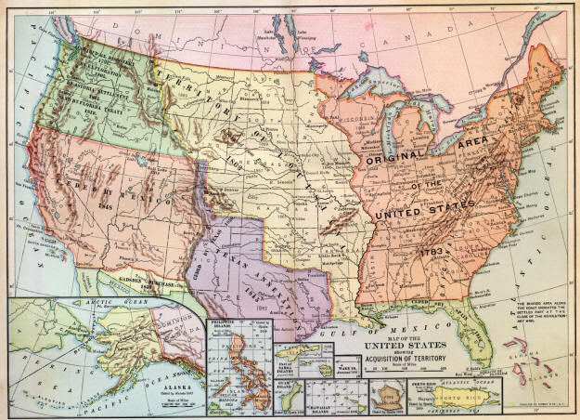

Slide 22
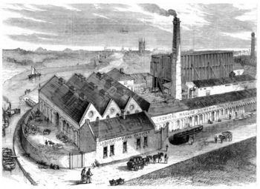
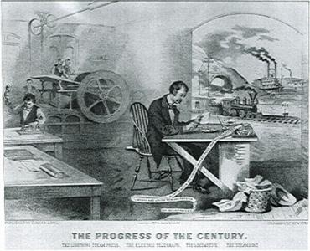
1805-1810
1805: Cotton begins to replace Tobacco as main cash crop of the South
1810: Total Population = 7.2 million
  Ag exports = $40 million
  87% of total exports
  Beginning of the “Industrial Revolution”

Slide 23
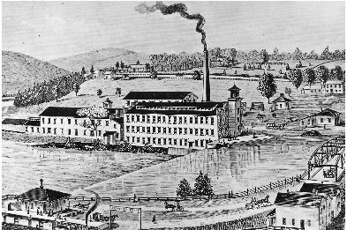
North Vs. South
North :
South:
Industrialized
Exporting manufactured goods
Immigrant Boom
Overall population increased
Exported:
  Cotton, sugar, rice, tobacco, wheat
Depended heavily on food imported from upper Mississippi valley
Plantation system dependent on slave labor
Population stagnated

Slide 24
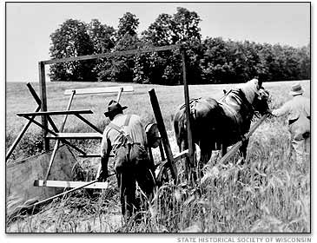
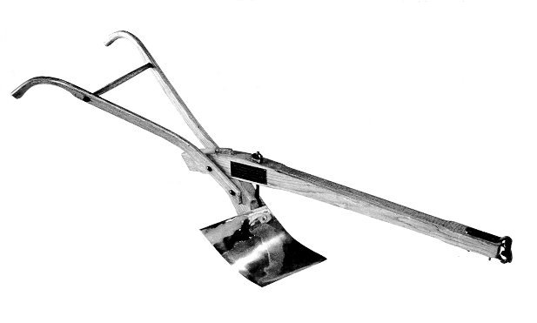
1810-1850
1819 = U.S. canning industry started.
1831 = the grain reaper invented.
1837 = John Deere manufactures
the steel plow.
1843 = founding of the commercial fertilizer industry by developing a process for making superphosphate fertilizer.
1845-1855 = Great Potato Famine in Ireland
1850 = mechanical cotton picking machine developed.

Slide 25
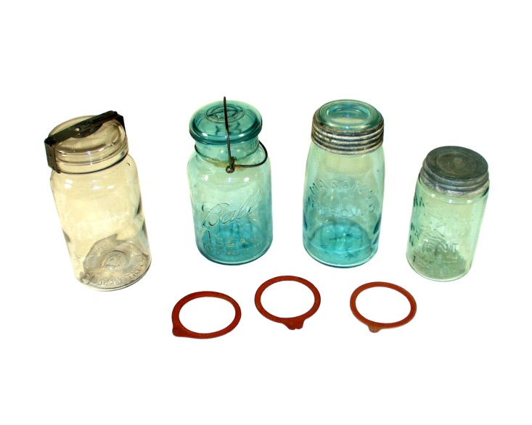
1850-1860
1855 = Michigan and Pennsylvania established the first state agricultural colleges.
1856 = A patent for condensing milk was issued to Gail Borden.
1858 = Mason jars, used for home canning, were invented.

Slide 26
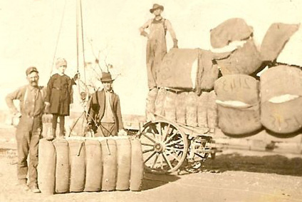
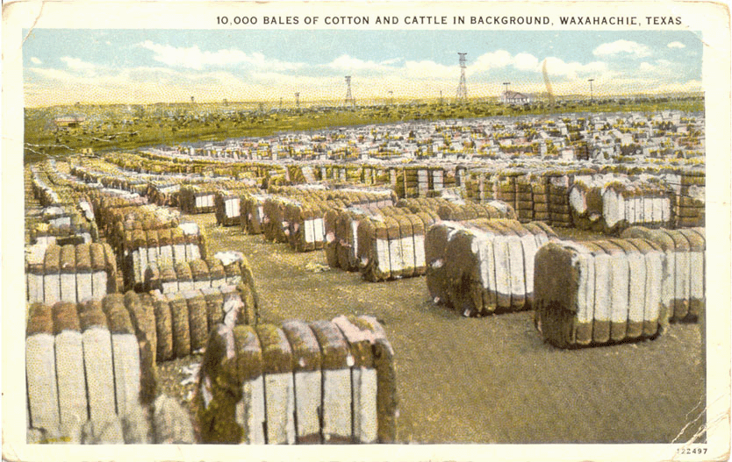
The “Cotton Boom”
1790: U.S. exported 3,000 bales of cotton
1793: Invention of Cotton Gin
1831: U.S. exports 800,000 bales of cotton
1860 = 5 million bales
  Cotton now accounted for 2/3 of all U.S. foreign trade
  The American South was the world’s top cotton producer

Slide 27
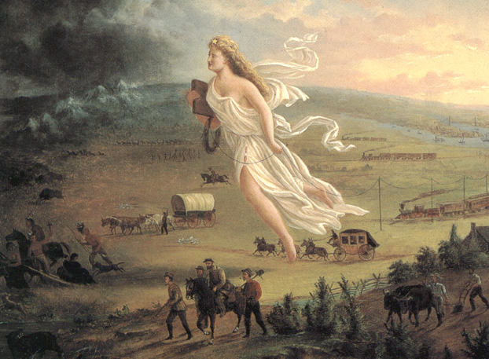
Manifest Destiny: 1840s
The idea that America had a special destiny to stretch across the continent motivated many people to migrate West.
In 1845 John L. O'Sullivan, editor of the Democratic Review, referred in his magazine to America's "Manifest Destiny to overspread the continent allotted by Providence for the free development of our yearly multiplying millions." One of the most influential slogans ever coined, "manifest destiny" expressed the romantic emotion that led Americans to risk their lives to settle the Far West.

Slide 28
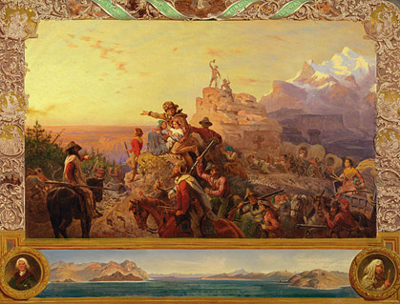
Manifest Destiny: 1840s
Manifest Destiny led expansionists to demand the U.S. should own the entire Pacific Northwest all the way to the southern border of Alaska.
Many invoked the idea to justify Indian removal, war with Mexico, and American expansion into Cuba and Central America.
More positively, the idea of Manifest Destiny inspired missionaries, farmers, and pioneers, who dreamed of transforming the great plains and fertile valleys into farms and small towns.

Slide 29
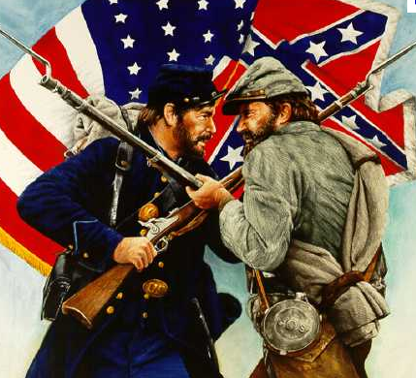
Civil War: 1861-1865
North: preserve the Union and end slavery
South: to preserve economy and way of life
  At least 50% of population was slaves

Slide 30
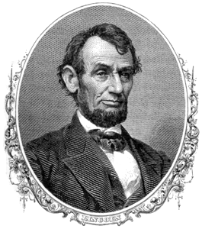
1862: Lincoln Legacies
President Lincoln created the USDA
  “The “People’s Department”, as Lincoln called it, was created to “acquire and to diffuse ….useful information on subjects connected to agriculture.”
Signed Morrill Act
  Gave each state 30,000 acres of public land per seat held in Congress to build and maintain Agricultural Colleges
    1887: Hatch Act granted more land/funds for Ag Research
    1890: 2nd Morrill Act funded black Agricultural Colleges

Slide 31
Investment in the Country’s Future Food Production & Supply
Government support of science, technology, and education to improve agriculture established a strong foundation for American agriculture
  Gave US a competitive edge over rest of world
  Development of new crop varieties (CA navel oranges, sugar beets for Midwest)
  Animal husbandry & nutrition
  Research in disease and pest management
  Fertilizer testing programs
  Information shared with farmers led continuous improvements in farm life and agricultural production

Slide 32
Post-Civil War South
The southern states were devastated by the Civil War.
  Georgia lost 66% of its developed resources during the war.
Pre Vs. Post War Example:
  Pre: Georgia had 1000+ plantations that were at least 1,000 acres,
  Post: Farm size based on the area a man could manage through his own labor, with the assistance of his family or contracted labor.
Plantations were in poor condition
  Stock, mules and horses for plow-teams were scarce as was grain to feed them
  Most of the seed was old and poor quality from neglect during the war

Slide 33
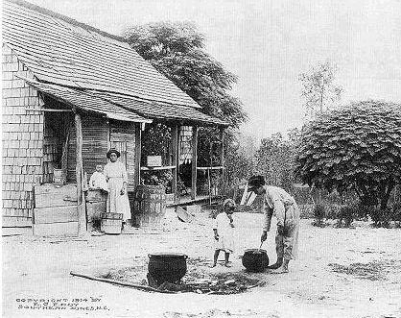
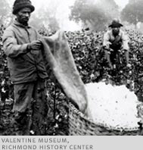
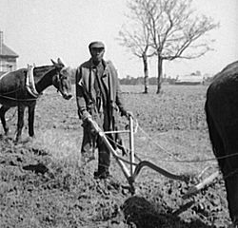
Reconstruction Era: 1860’s
4 million freed slaves
  Had no land, no $$ and little
  opportunity
Sharecropping: Southern form of tenant farming
    Employed ex-slaves and other poor workers to farm plantations (cotton, tobacco) in exchange for part of the harvest
    Many sharecroppers frequently were cheated and exploited
    System remained for decades

Slide 34
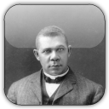
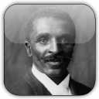
African American Ag Innovators
Booker T. Washington
    Believed Education = Emancipation
    First Head of the Tuskegee Institute in AL
        Provided Agricultural education/training for African Americans
George Washington Carver
  Agricultural Scientist at Tuskegee
  Taught soil conservation w/ crop rotation
  Traveled to African American farms to demonstrate better farming methods
  Introduced profitable new crops to grow vs. cotton
  Peanuts
    Discovered new varieties
    Created new uses
    Establishing a new industry for the South

Slide 35
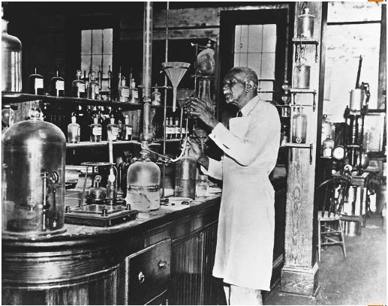
George Washington Carver Discoveries
From peanuts: 300+ products including:
  milk, cheese, cream, coffee, plastics, paper, wood stains, flour, soap, linoleum, cooking oils, cosmetics, etc…
From peanuts: 300+ products including:
  milk, cheese, cream, coffee, plastics, paper, wood stains, flour, soap, linoleum, cooking oils, cosmetics, etc…
From sweet potatoes: 118+ products including:
  starch, tapioca, molasses, feed for livestock, dyes, flour, vinegar, ink, and synthetic rubber.
From cotton:
  paving blocks, cordage, paper, fiber for rope, etc…

Slide 36
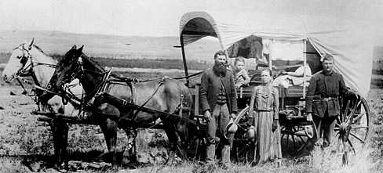
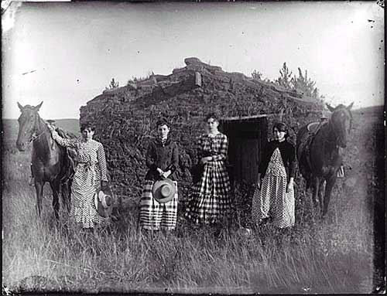
1862: The Homestead Act
Westward expansion pushed the agricultural frontier onto the Great Plains.
Westward expansion pushed the agricultural frontier onto the Great Plains.
The Homestead Act offered 160 acres of FREE land to settlers who would farm it for 5 years.
Homesteaders rushed to fill the open lands.
Homesteading also brought fresh waves of immigrants – “Sodbusters”
The Great Plains soon became America’s breadbasket, the rich soil yielding bountiful harvests of wheat and corn.
Notes:
http://www.youtube.com/watch?v=wJHOqvlntoc&feature=results_video&playnext=1&list=PL8C32730BE04D472D

Slide 37
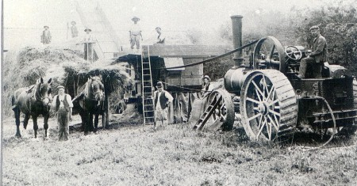
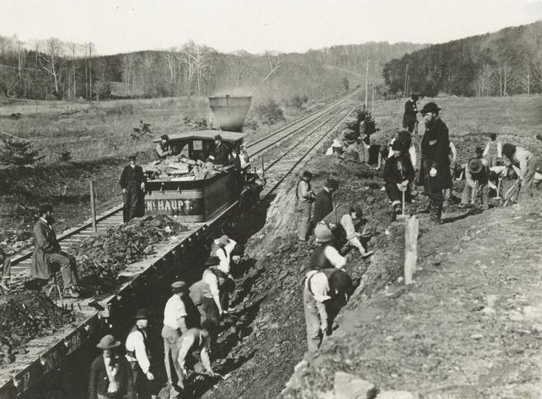
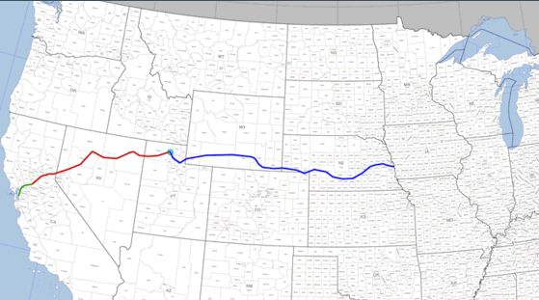
1860’s: Reconstruction Era
1861 = Pasteurization invented.
1867
  Barbed wire invented.
  Cattle boom.
    Range wars break out between ranchers and farmers.
1869 Transcontinental railroad completed.

Slide 38
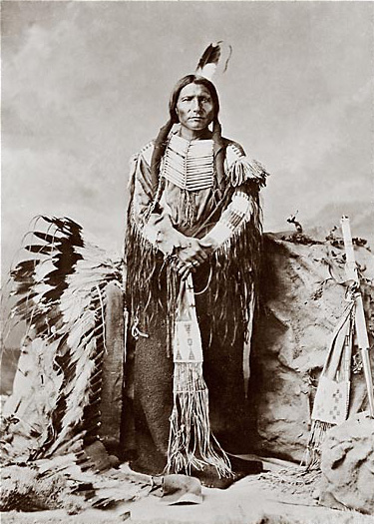
Plight of The Native Americans
Bison population nearly extinct by 1870
Continual forced movement westward by the U.S. government
1887 Dawes Act divided up tribal land for Native Americans but also sold remaining plots to Homesteaders
  Finally reversed in 1934
Severely impacted Native American tribes, communities, structure, organization and ability to survive in the newly Homesteaded Prairie

Slide 39

The Development of the Industrial United States: 1870-1900
1869: Wilbur Atwater, “Father of Human Nutrition” first discovered and published chemical compositions of foods
  Later research focused on nutritional quality of cooked/processed foods
1870: Refrigerator railroad car patented.
1881: Hybrid corn produced.
Mid 1880’s
  Texas = Main Cotton state
  MN, CA, IL = Main Wheat states
1887: The Hatch Experiment Station Act was passed
  Provided federal grants to states for agricultural experimentation.

Slide 40

1880 – 1890 Stats
1880
Total Population
  50 million
Farmers
  49% of labor force
Number of farms:
  4 million
Average acres
  134 acres
1890
Total Population
  63 million
Farmers
  43% of labor force
Number of farms:
  4.6 million
Average acres
  136 acres

Slide 41

The Emergence of Modern America: 1870-1900
1888 = The first long haul shipment of a refrigerated freight car was made from California to New York.
1892 = The gasoline tractor was built by John Froelich.
1890-1899
  Average annual consumption of commercial fertilizer
    = 1.8 million tons
1895 = Automobile patent issued
1898 = New Wheat Varieties imported from Russia
  By 1904 Wheat production went from
  60,000 to 20,000,000 bushels per year
1902 The Reclamation Act was passed
  Lead to water projects for irrigation.

